Slide 1

Bulk Message& E-Mail service

Slide 2
INTRODUCTION TO BULK SMS
Bulk mailing sends a large number of SMS messages for delivery to mobile terminals. It is used by media companies, businesses, banks for marketing and fraud prevention and consumer brands for various applications, including entertainment, business marketing, and mobile marketing. Messaging is widely used for alerts, reminders, marketing, but also for information and communication between staff and customers. Bulk messaging allows you to send SMS messages to mobile phones.

Slide 3
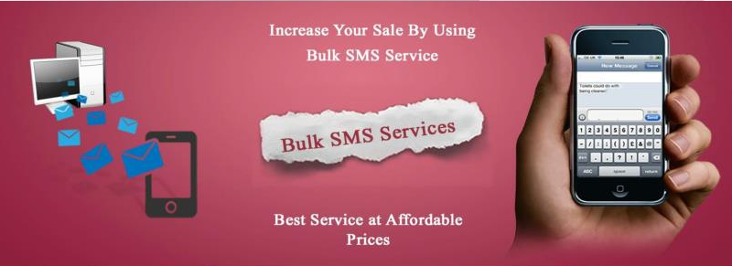
BULK EMAILS AND SMS SERVICES

Slide 4
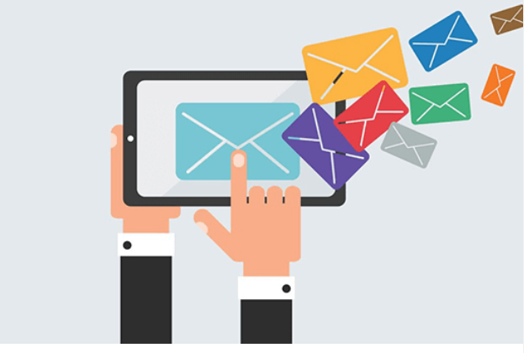
BULK EMAIL / SMS FEATURES

Slide 5
FEATURES
Unlimited dynamic sender ID, SMS can be pressed by a dynamic sender ID
SMS messages can be pushed from a small response number that allows the recipient to return
User-friendly interface for reading responses
fast delivery guaranteed

Slide 6
FEATURES
High- end API, SMPP connectivity and software integration
Facility of Life does not interfere with gateways
Client and database protection

Slide 7
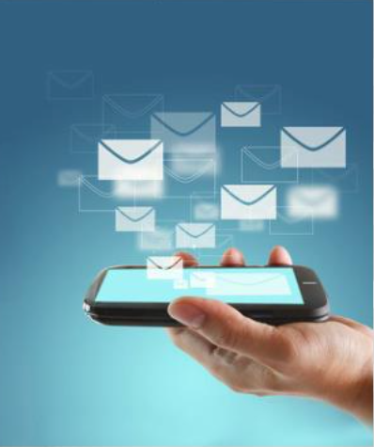
METHODOLOGY
India has one of the densest and prospective markets for
cellular phones, and mobile service providers have a strict policy
about providing access to their customers bases . Many consumers
activate “Do not Disturb” services that disallow mass publicity calls
and messages . However , bulk SMS service provider in Mumbai
maintain database of people who are open to mass messages. This
means that a audience more efficiently. Not all bulk SMS reseller
providers have extensive resources however, and it is up to you to
select the right vendor.

Slide 8
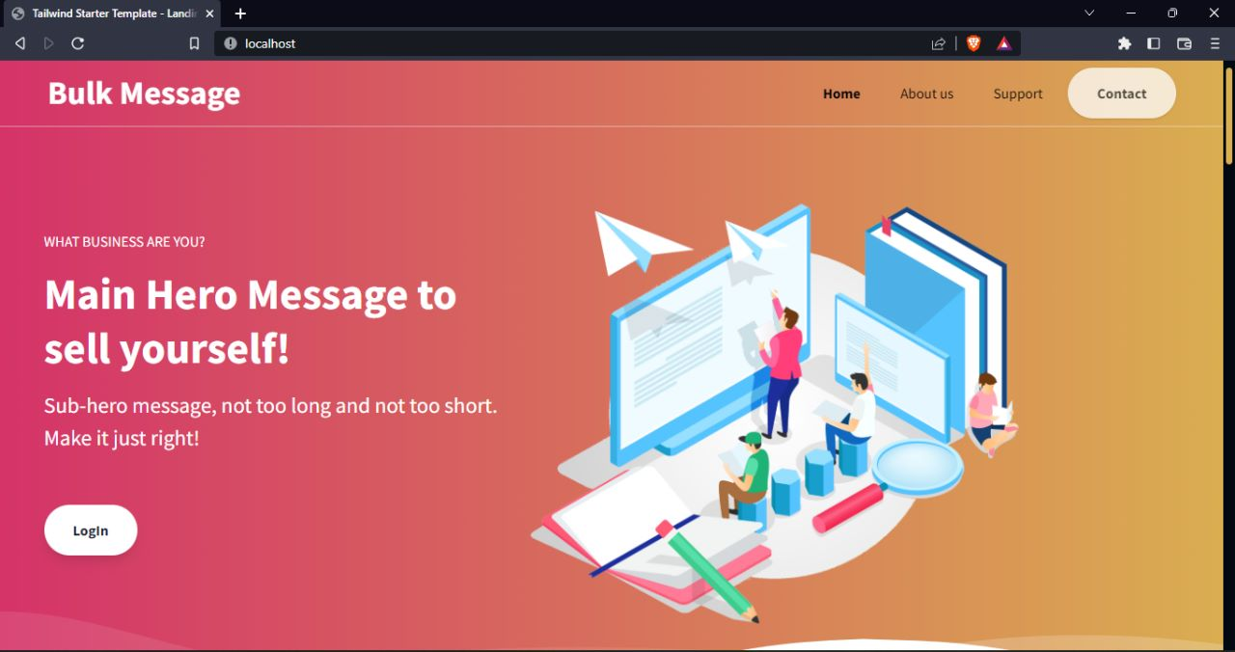
WORKING IMAGE

Slide 9
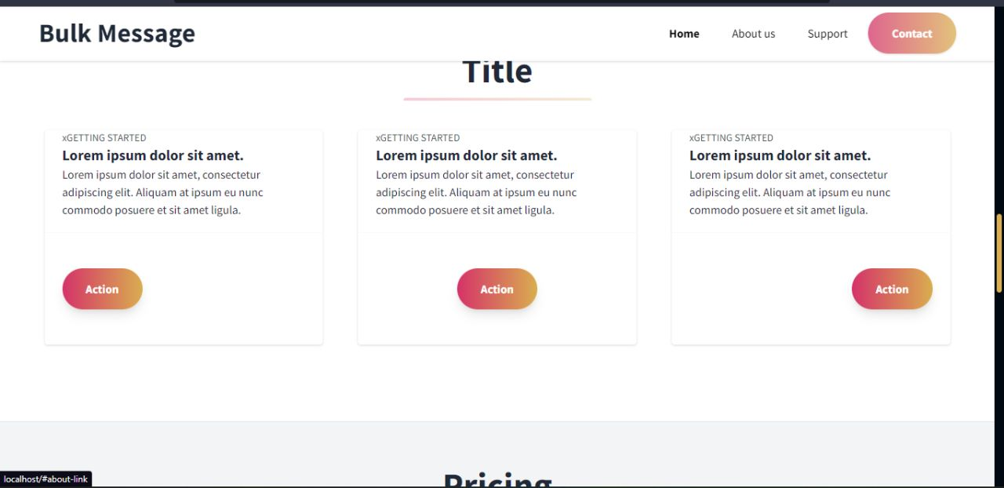
TYPES :

Slide 10
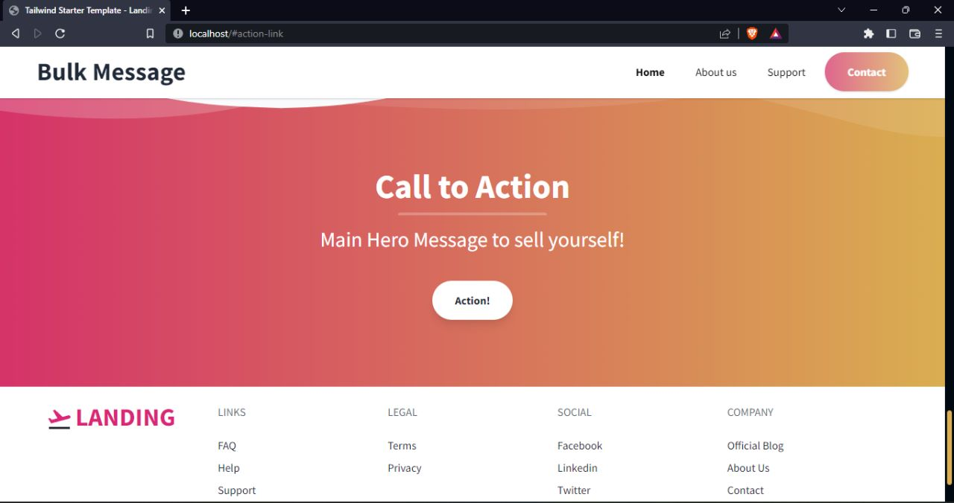
Contact Information:

Slide 11
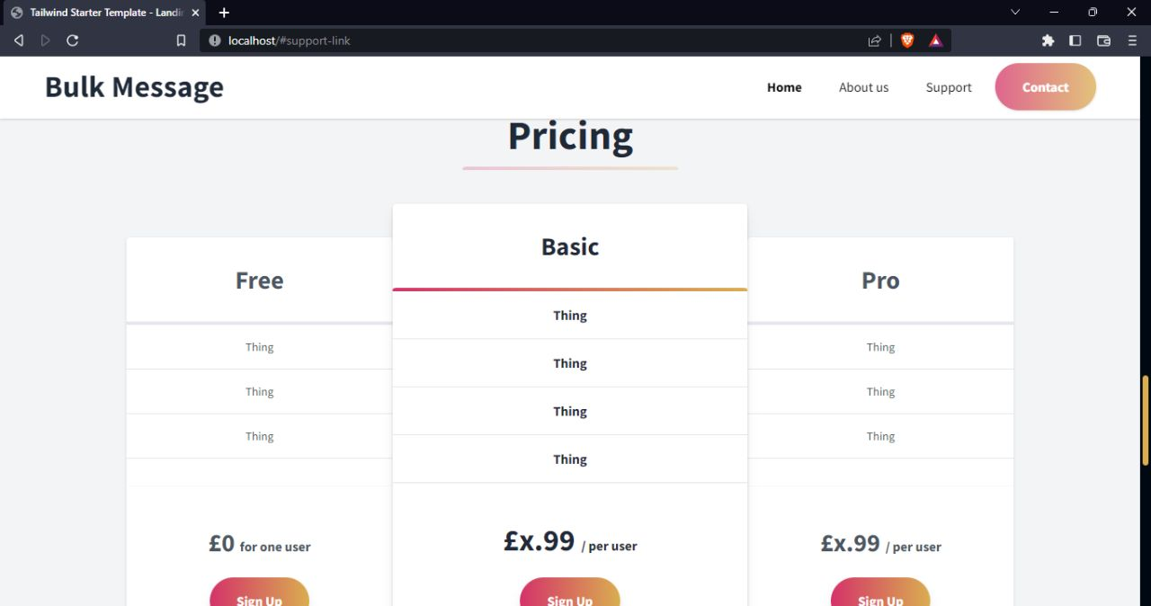
Pricing Details:

Slide 12
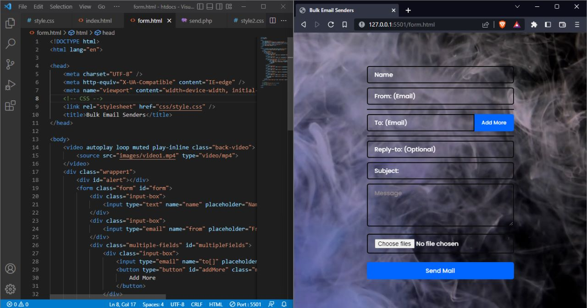
Form Page:

Slide 13
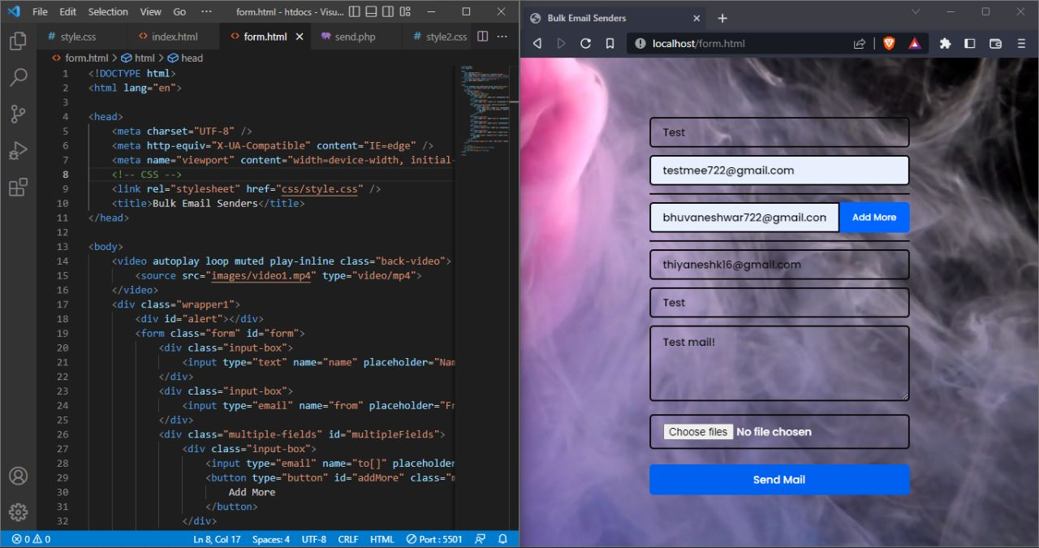
Entering details:

Slide 14
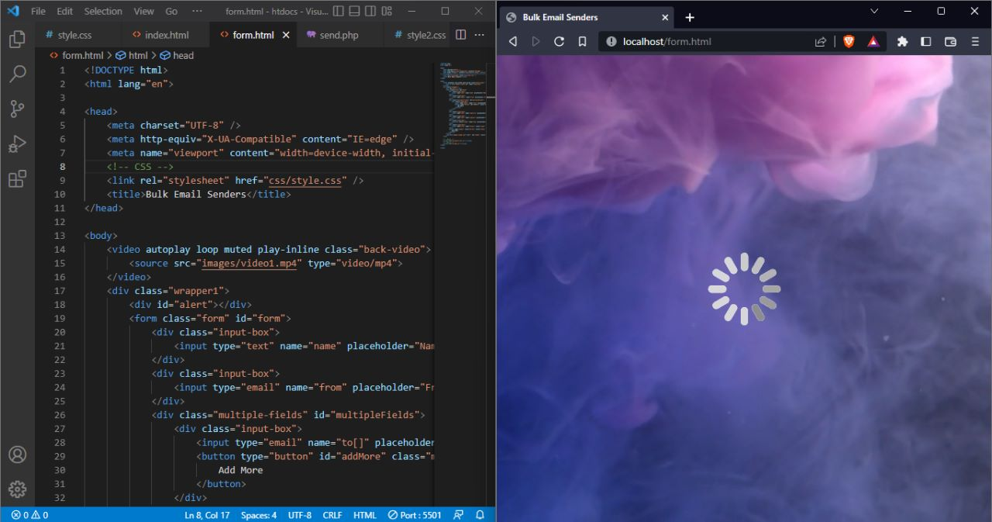
Loading Page:

Slide 15
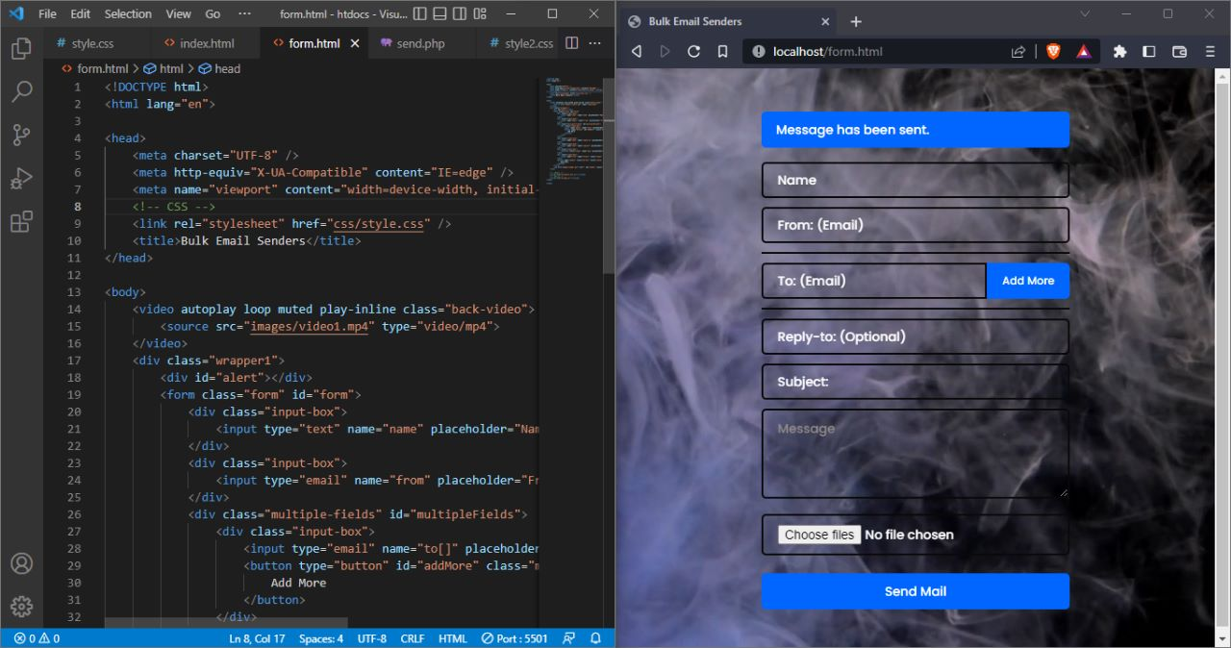
Message Sent Screen:

Slide 16
CONCLUSION
The purpose of marketing. We understand the importance of marketing keeping in mind the product of service offered by the client. We plan the marketing schedule based on maximum impact. Promotion is an integral part of business and timely promotion is the most effective way of generating business.
The project is widely useful in organisation , colleges , banking , companies ,market-news , e-commerce , government and public utilities , logistics , media and entertainment , travel and tourism etc.

Slide 17
THANK YOU
G AVINASH S BHUVANESH K THIYANESHWAR

